Slide 1
Uncontrolled copy not subject to amendment
Map Reading
Learning Outcome 1
Know about the scales and features of Ordnance Survey maps
Version 2.10 OCT 2014

Slide 2
Definition
Map:
Noun
Flat representation of the earth or some part of it with its physical or political features or of the heavens

Slide 3
History
Ever since man has been able to write and draw there is evidence to also show that he has recorded routes on land and sea.
Where maps were originally shown on clay tablets and papyrus, we can now display them on paper and even CD Rom!

Slide 4
The World
The earth is a sphere (oblate spheroid if you want to be precise!)
Rotates on its axis – North / South pole (called True North / True South)
A imaginary line runs around the middle dividing North “hemisphere” and South “Hemisphere” – called the Equator

Slide 5
Curved or Flat?
The world is a sphere
Maps are flat
So how do you make a curved spherical earth fit on a flat piece of paper?

Slide 6
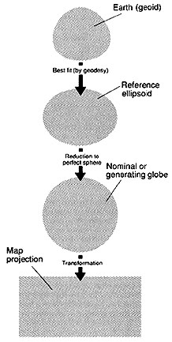
Map Projections
One big lie!
Flat maps are a compromise of accuracy over practicality
Squashed, pulled and distorted versions of the globe
As the maps we use represent small areas, then distortion is negligible

Slide 7
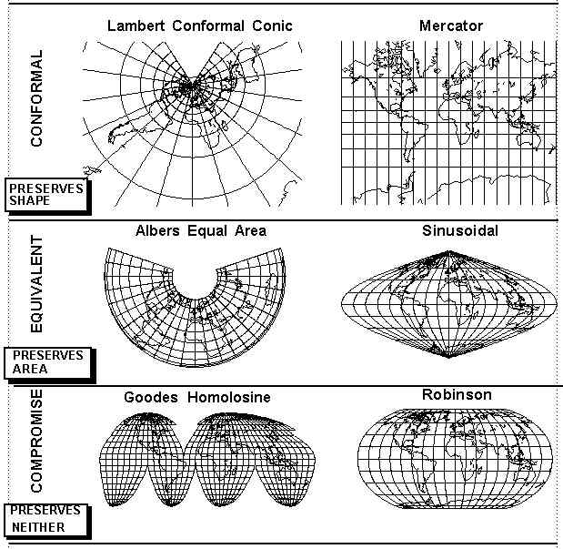
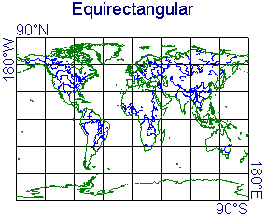
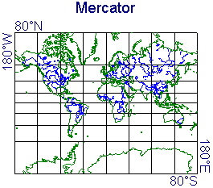
Example Projections

Slide 8
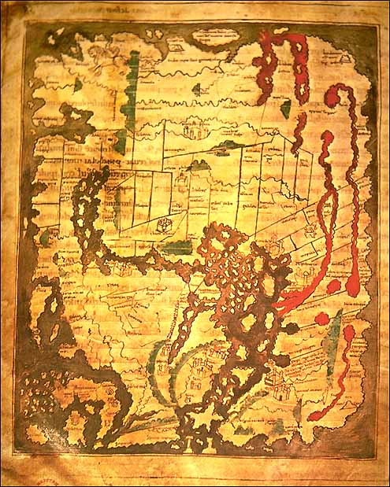
13th Century Britain

Slide 9
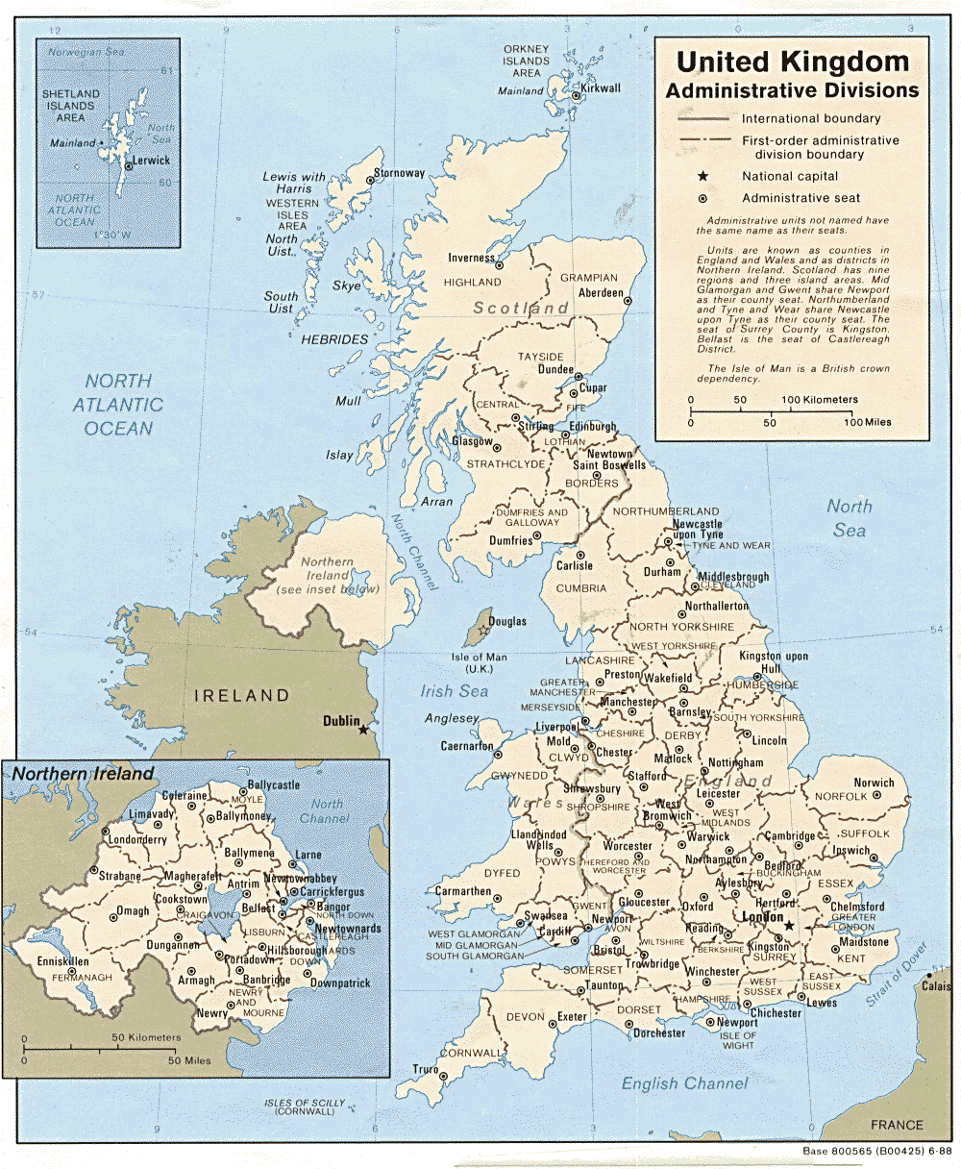
Modern Maps
Very Accurate
Created from satellite images and photographs
Are our interpretation of the world around us
Used for a variety of purposes

Slide 10
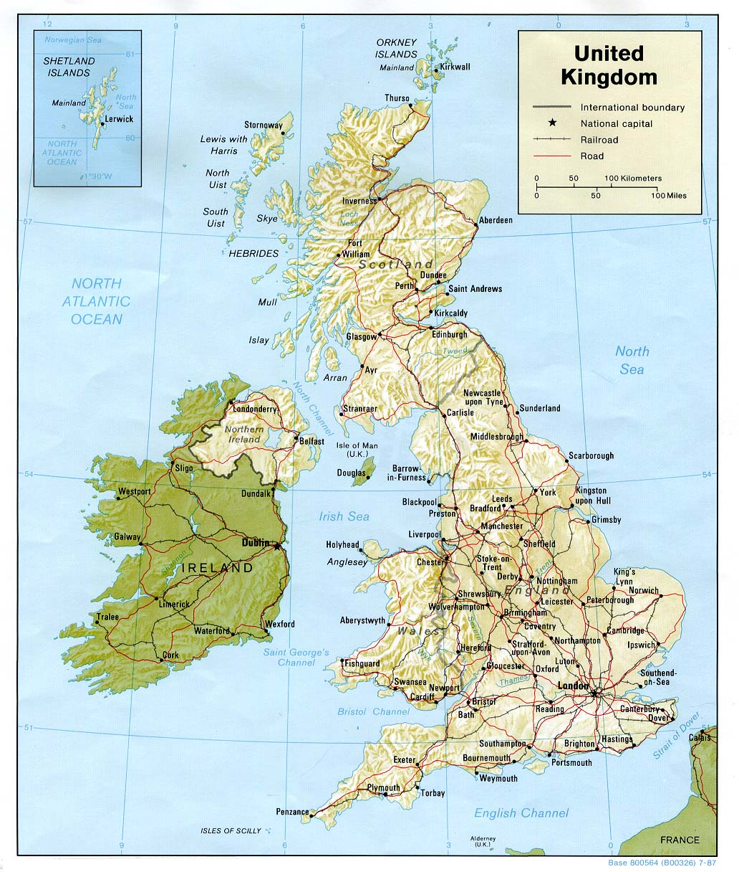
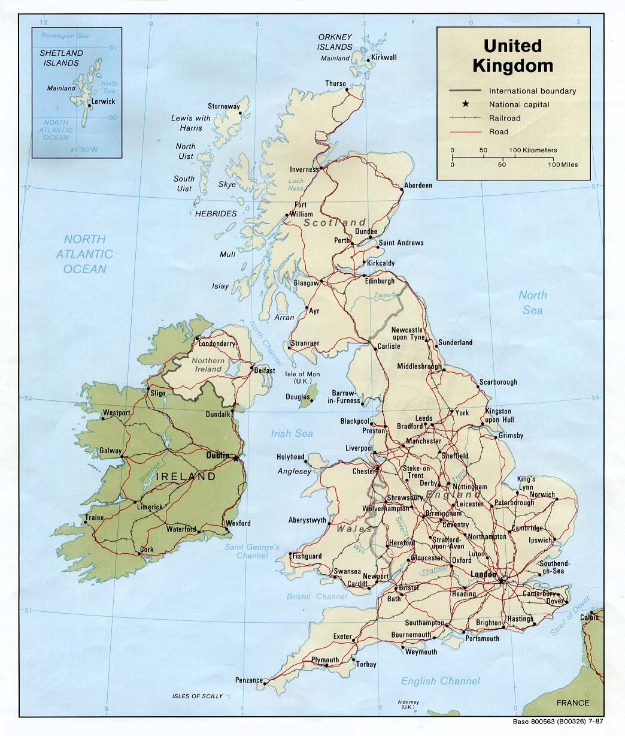
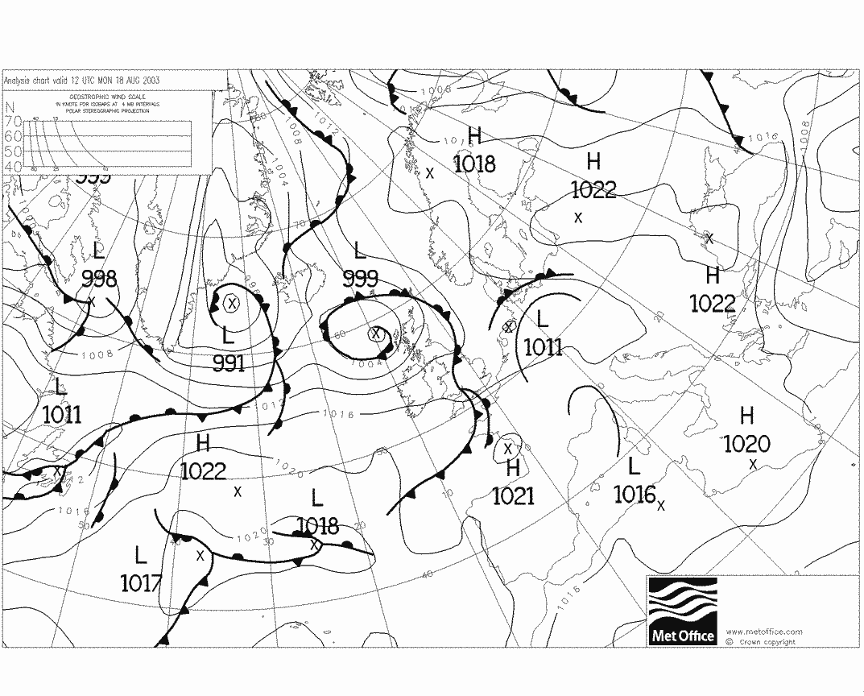
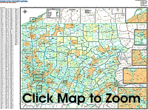
What kind of maps are there?

Slide 11
What kind of maps are there?
Examples…
  Topographic – shows shape of land
  Demographic – shows population info
  Synoptic – shows weather info
  Political – shows boundaries, major cities
  Historical, marine, outline

Slide 12
Topographic Maps
Show:
  Relief (hills, valleys, cliffs, etc)
  Drainage (rivers, lakes, steams, etc)
  Vegetation (forests, trees, swamps, etc)
  Man-made features (towns, canals, phone boxes, etc)

Slide 13
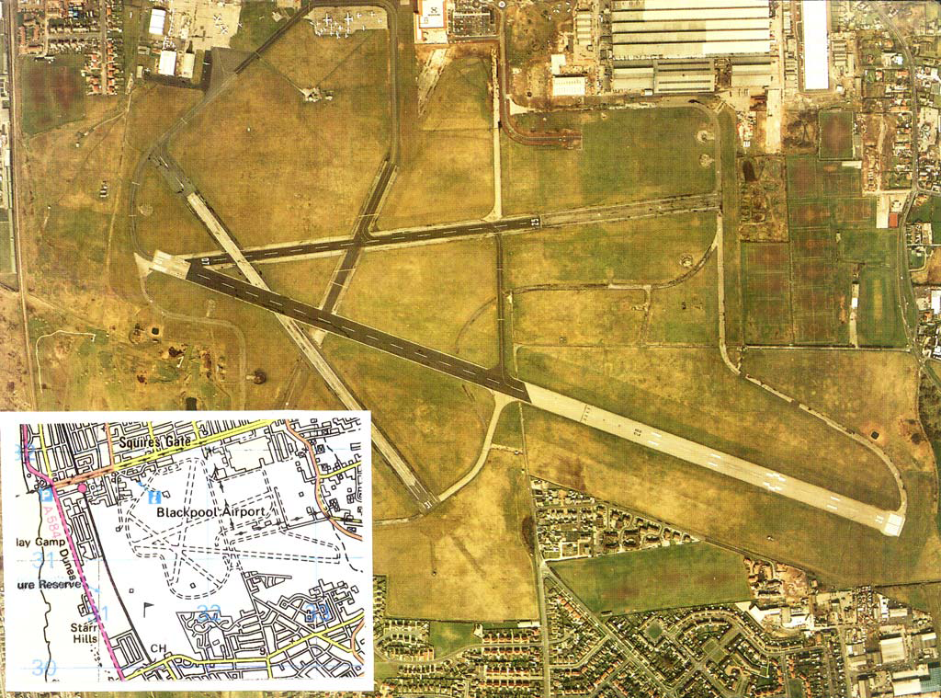
Blackpool Airport

Slide 14
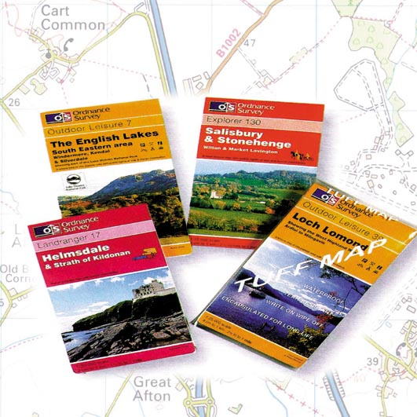
The Ordnance Survey Map
Ordnance Survey
maps come in a variety of different formats and this guide will show you how to choose which one is best suited for your own use.

Slide 15
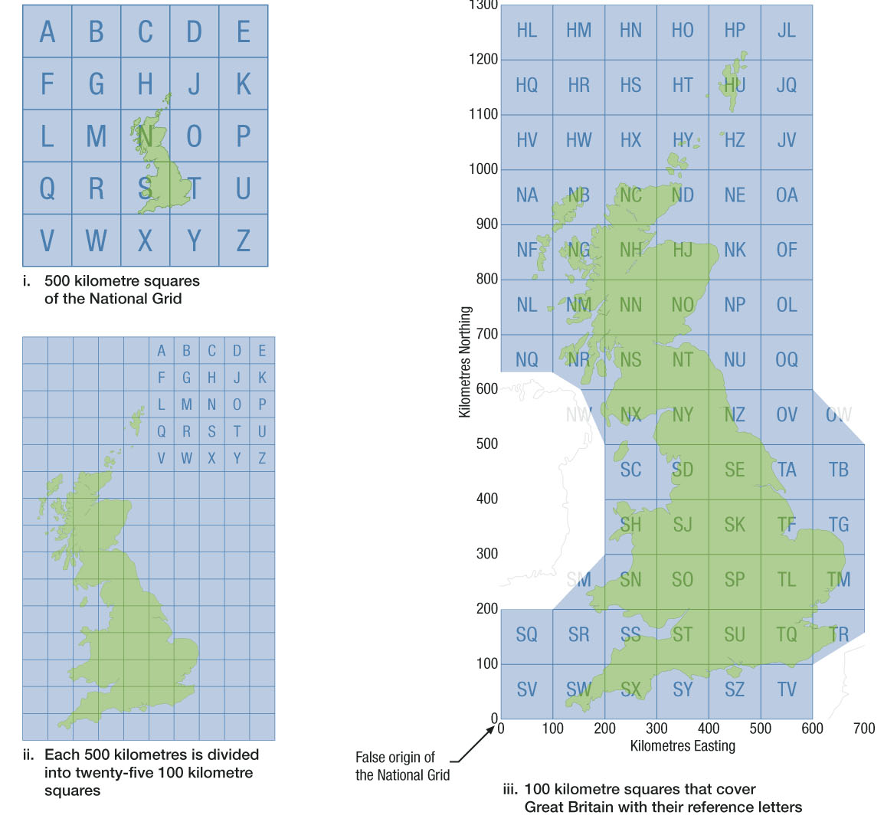
Tourist Information
National Grid

Slide 16
Types of Map
The importance of choosing the right map

Slide 17
Map Scales
The higher the number on the right of the scale:
  the bigger the area covered
  The lower the detail
Detailed town planning – 1:5000 or 1:10000
Air Navigation – 1:250000 or 1:1000000

Slide 18







Map Scales

Slide 19
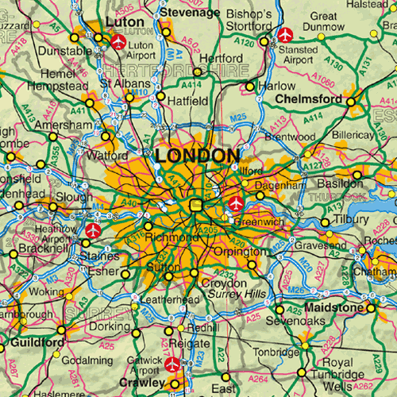
Map Scales – 1:1000000

Slide 20
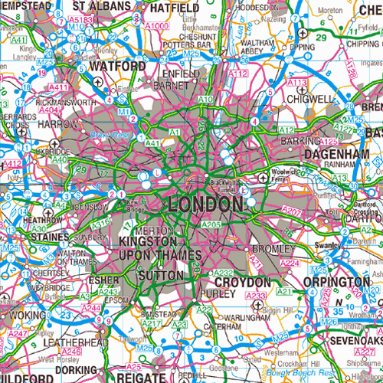
Map Scales – 1:625000

Slide 21
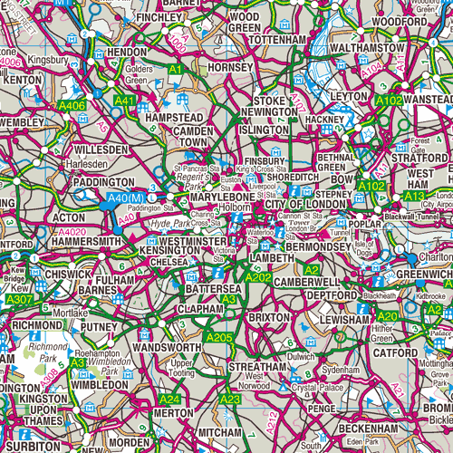
Map Scales – 1:250000

Slide 22
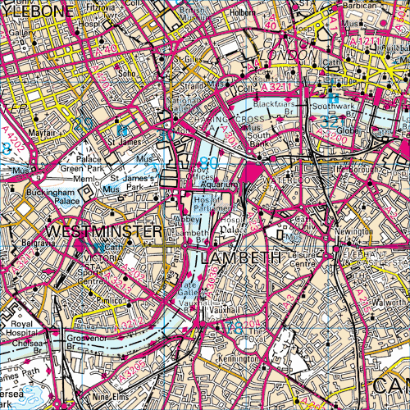
Map Scales – 1:50000

Slide 23
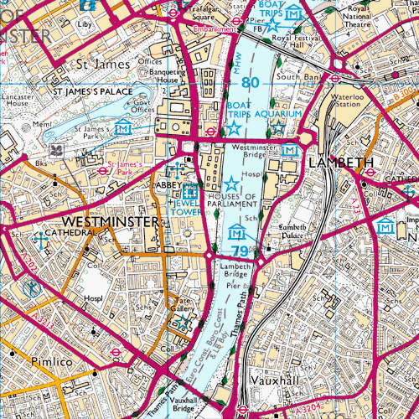
Map Scales – 1:25000

Slide 24
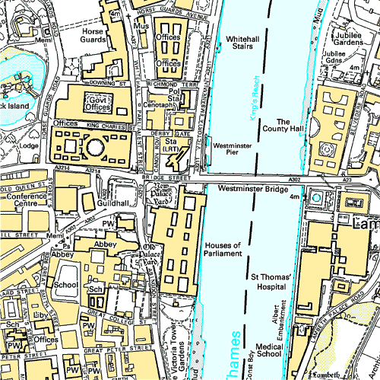
Map Scales – 1:10000

Slide 25
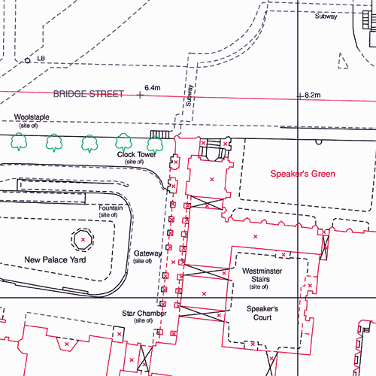
Map Scales – 1:1250

Slide 26
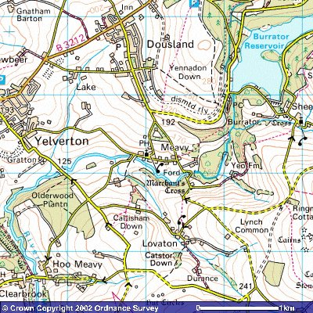
1:50000 – Popular for walking
1cm on the map represents 50000cm on the ground
50000cm = 500m = 1/2km
1 grid square = 2cm = 1km
Each map = 40km²
204 maps cover the UK

Slide 27
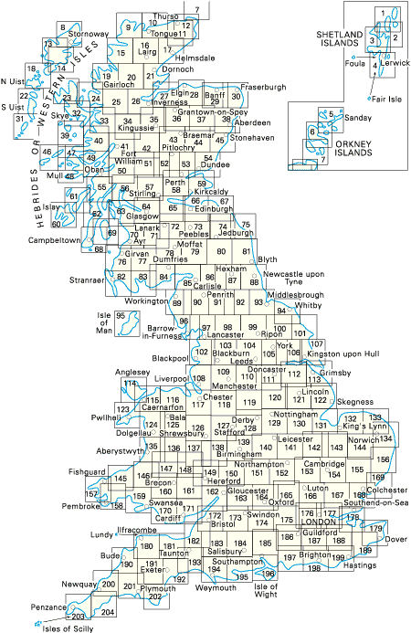
1:50000

Slide 28
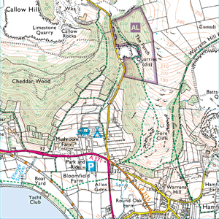
1:25000
Very detailed walking maps
1cm on the map represents 25000cm on the ground
25000cm – 250m = ¼km
1 grid square = 4cm = 1km
Each map can also be double-sided
403 maps cover the UK

Slide 29
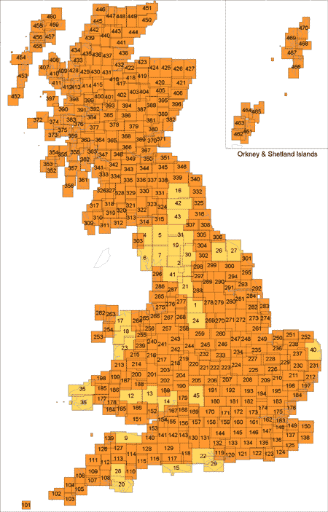
1:25000

Slide 30
Map Revision
Maps get changed on a regular basis
  Towns expand or change
  Rivers get diverted or dammed
  Etc.
Make sure your map is as up-to-date as possible
Check the Revision Date of the map

Slide 31
Looking after a Map
1:50000 maps cost around £6 each
Maps need to be protected
Should always be folded properly
Avoid marking maps, and NEVER with a pen! (soft pencil only!)

Slide 32
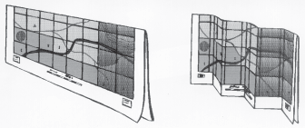
Folding a map

Slide 33
The Key
Remember, that the symbols are relevant only to the map you are using!
Symbols change across different manufacturers maps, and may even change across different versions!
If in doubt about a symbol, check the key!

Slide 34
Symbols
Ordnance Survey interpret both man made and natural features on the map, through a system of symbols.
Every Ordnance Survey map has a key showing the definition of each symbol to help you. We will look at a few of the more common symbols.

Slide 35
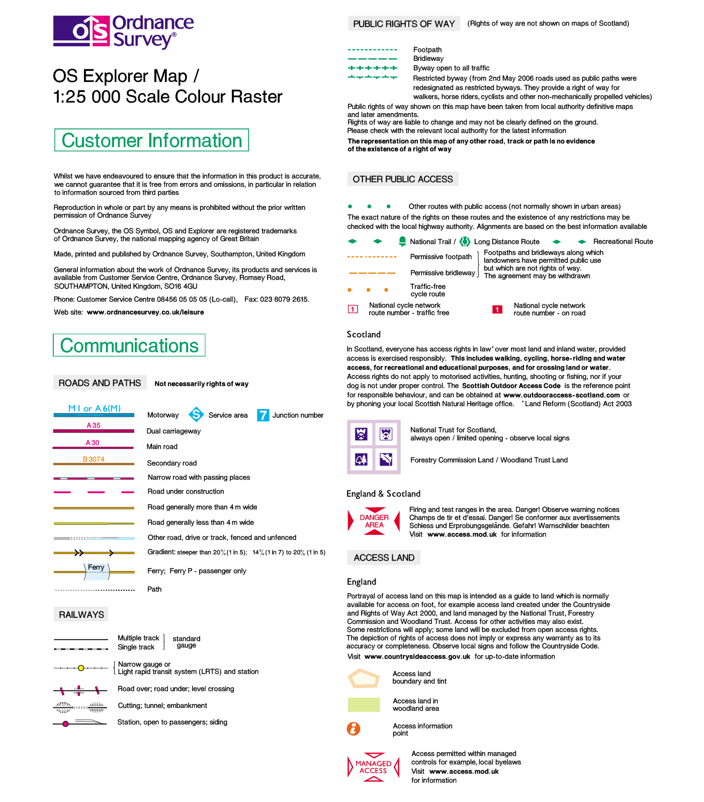

Slide 36
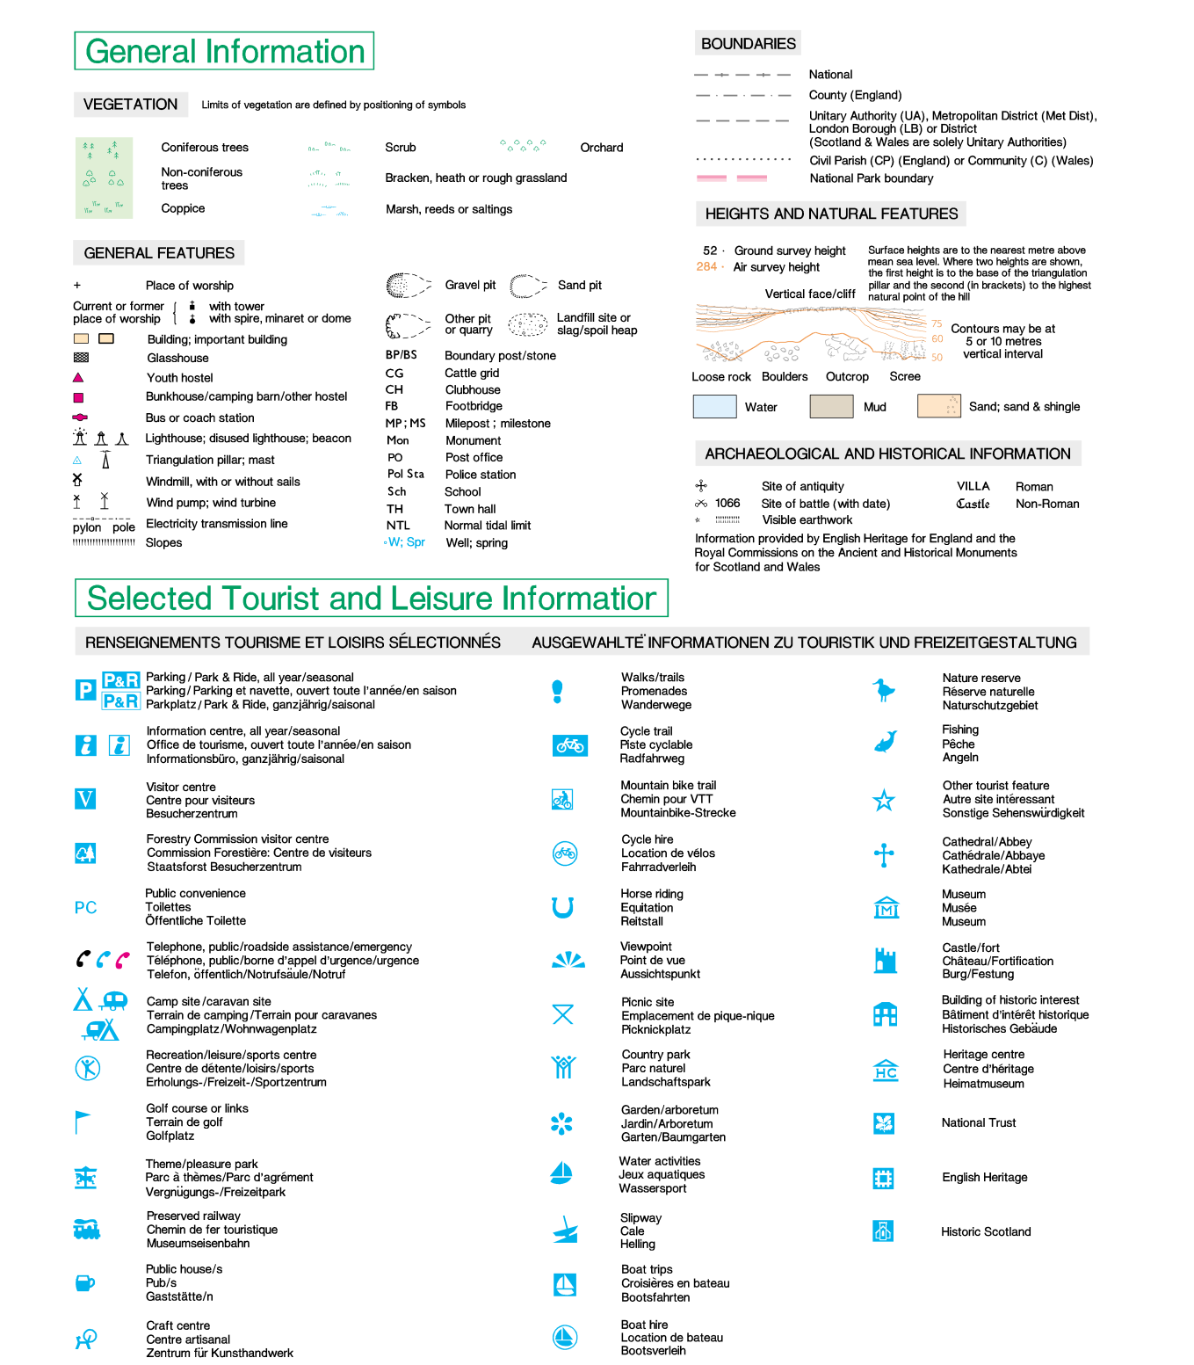

Slide 37
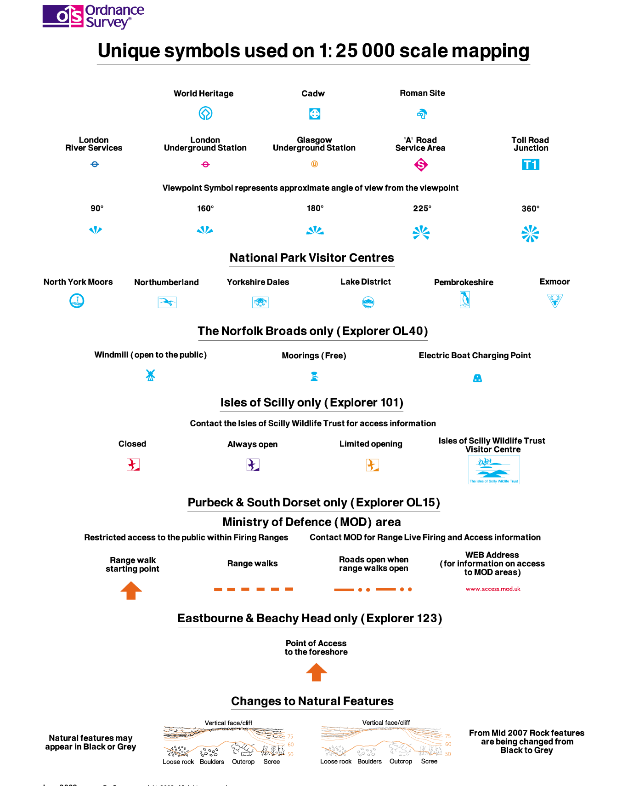

Slide 38
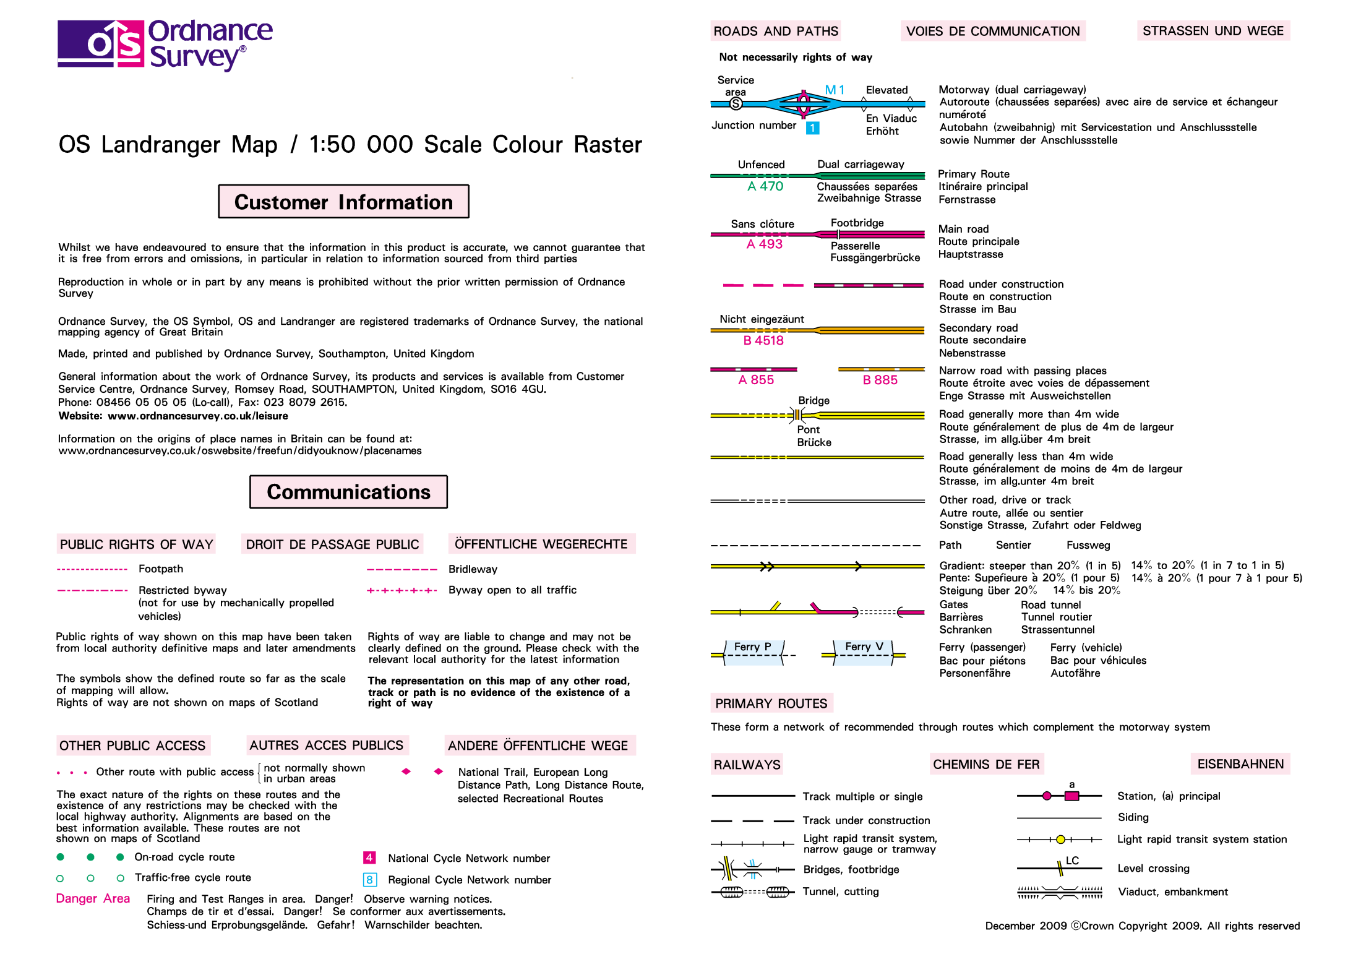

Slide 39
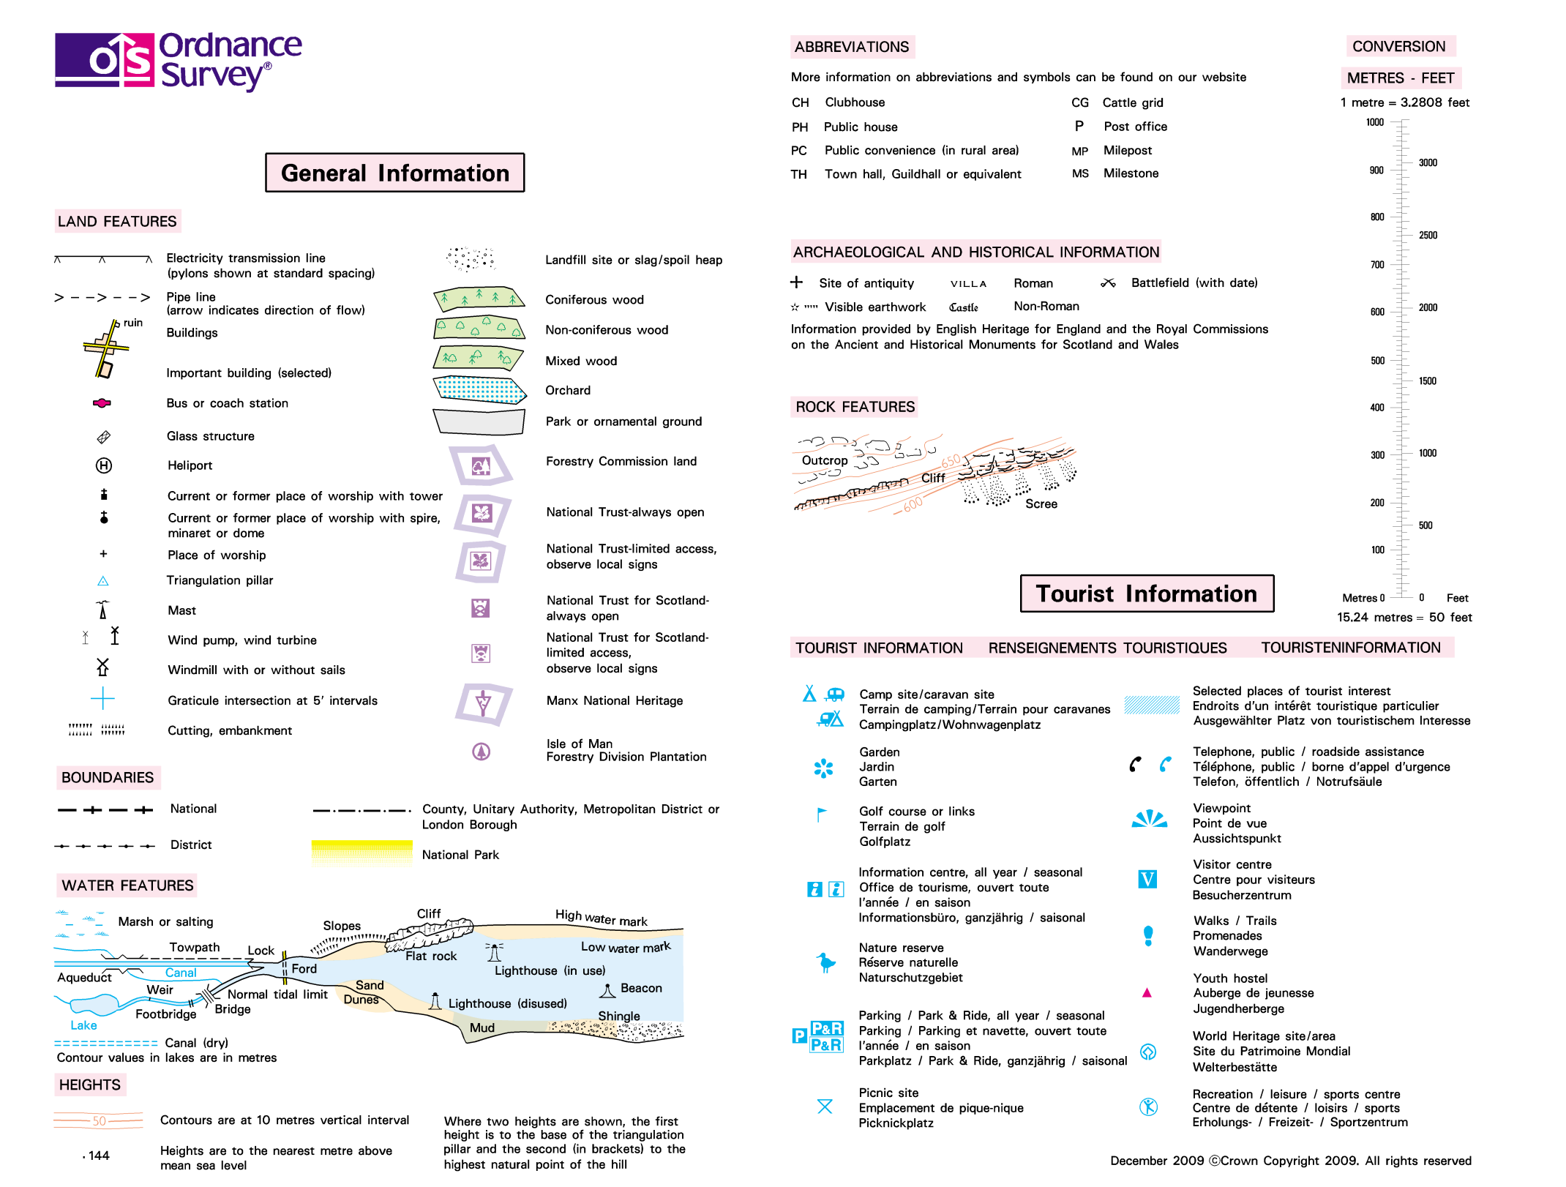

Slide 40
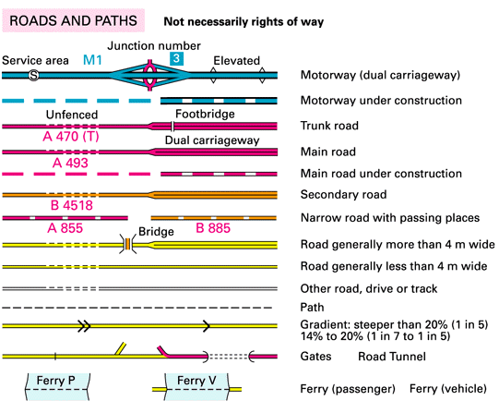
Map Symbols - Roads

Slide 41
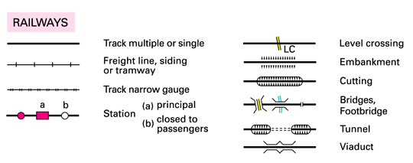
Map Symbols - Railways

Slide 42
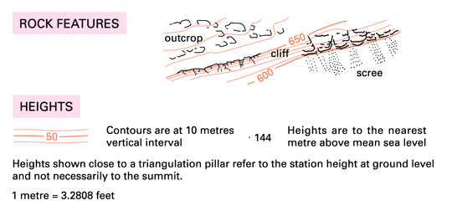
Map Symbols - Hills

Slide 43
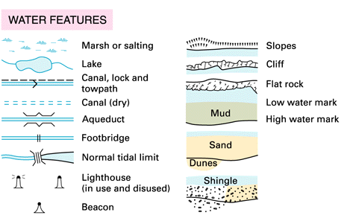
Map Symbols - Water

Slide 44
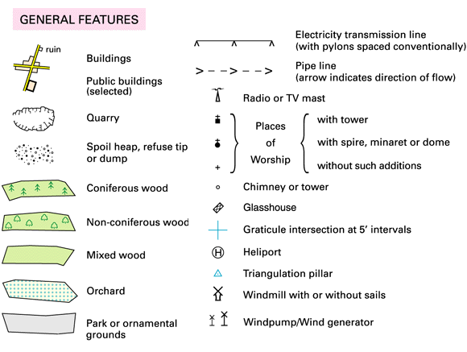
Map Symbols - General

Slide 45
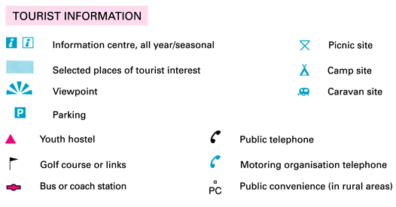
Map Symbols - Tourist

Slide 46
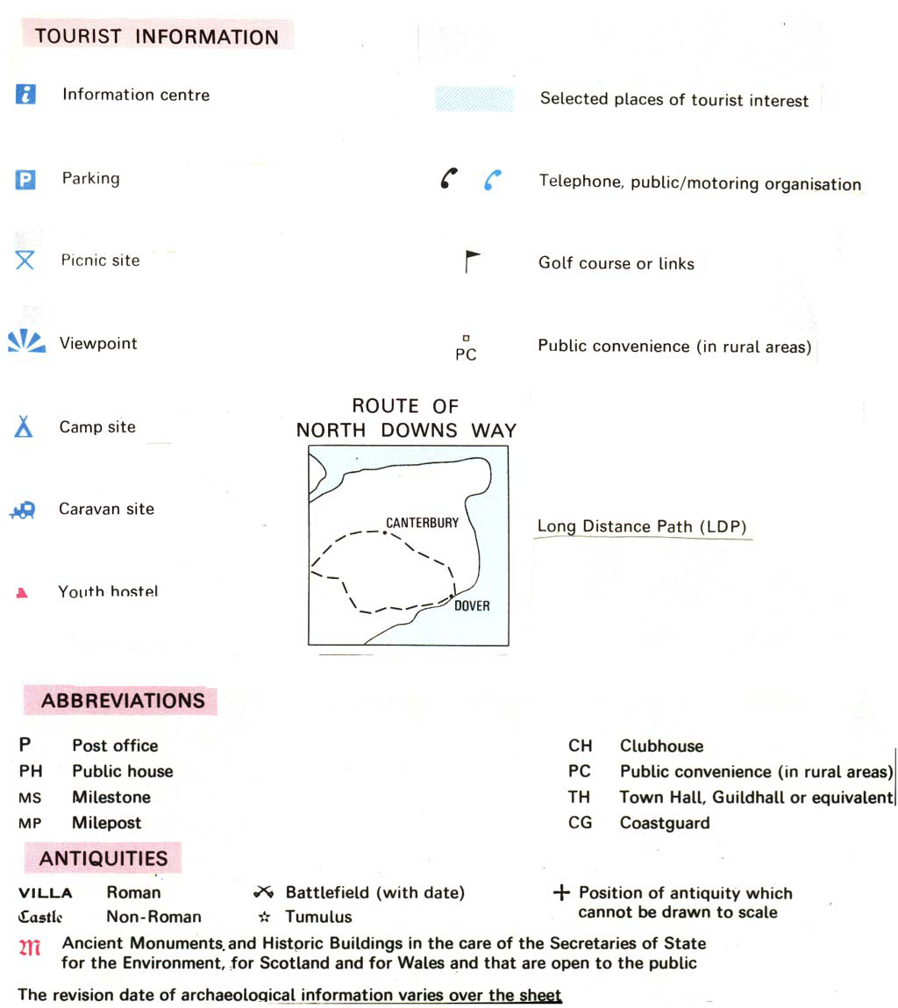
Tourist Information

Slide 47
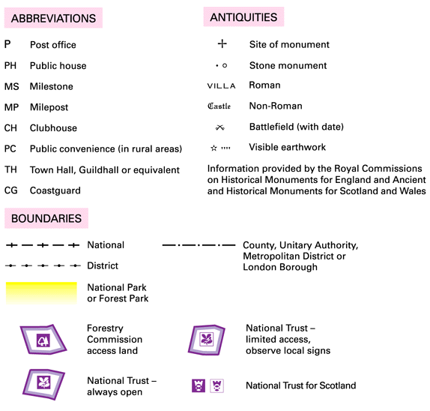
Other Map Symbols

Slide 48
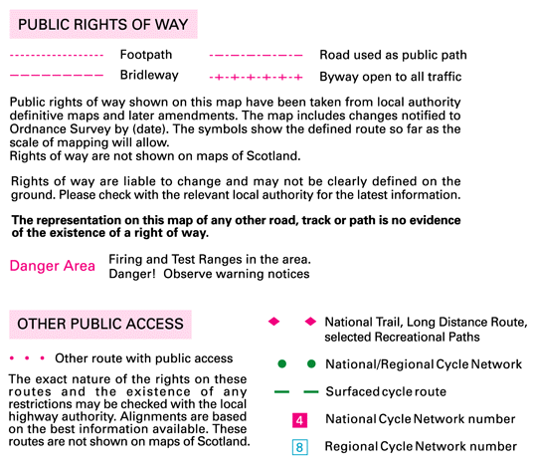
Map Symbols - Access

Slide 49
Hills
Hills are shown using contour lines
Contour lines join areas of equal height
Marked at every 10m of height change
Rise and fall called “Vertical Interval” (VI)
Contour lines seem to disappear at cliffs

Slide 50
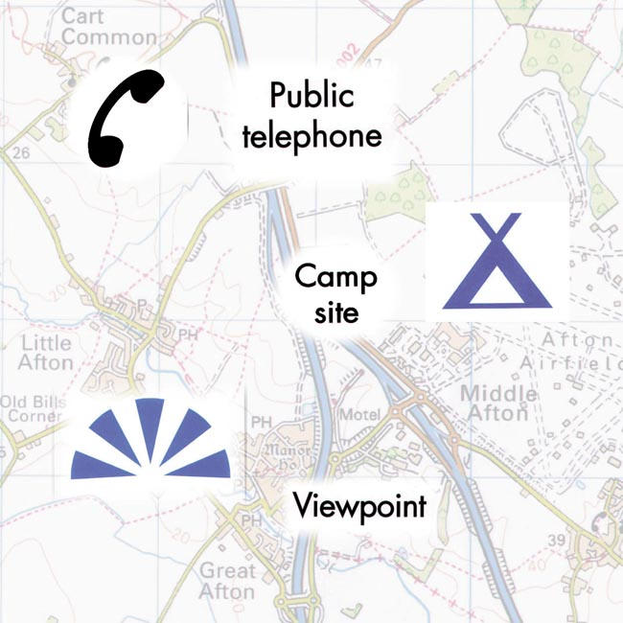
Symbol examples

Slide 51
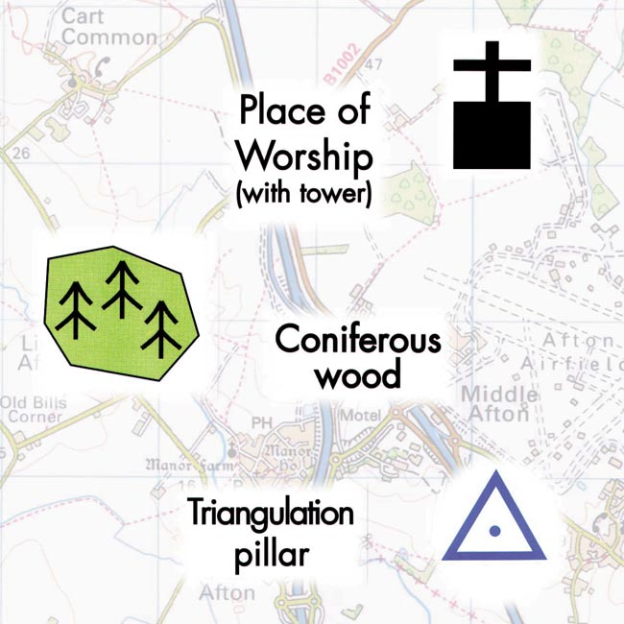
Symbol examples

Slide 52
Any questions?

